Slide 1
Publication Rates: Analysis of Faculty Research @ UR[ichmond] Data Analytics Bootcamp, Project 1 Kristine Nolin and Carol Wittig June 15, 2019

Slide 2
OUTLINE OF PRESENTATION:
Questions and Motivation
Data
Exploration and Cleanup
Analysis
Implications of our Findings
Limitations of Data Used

Slide 3

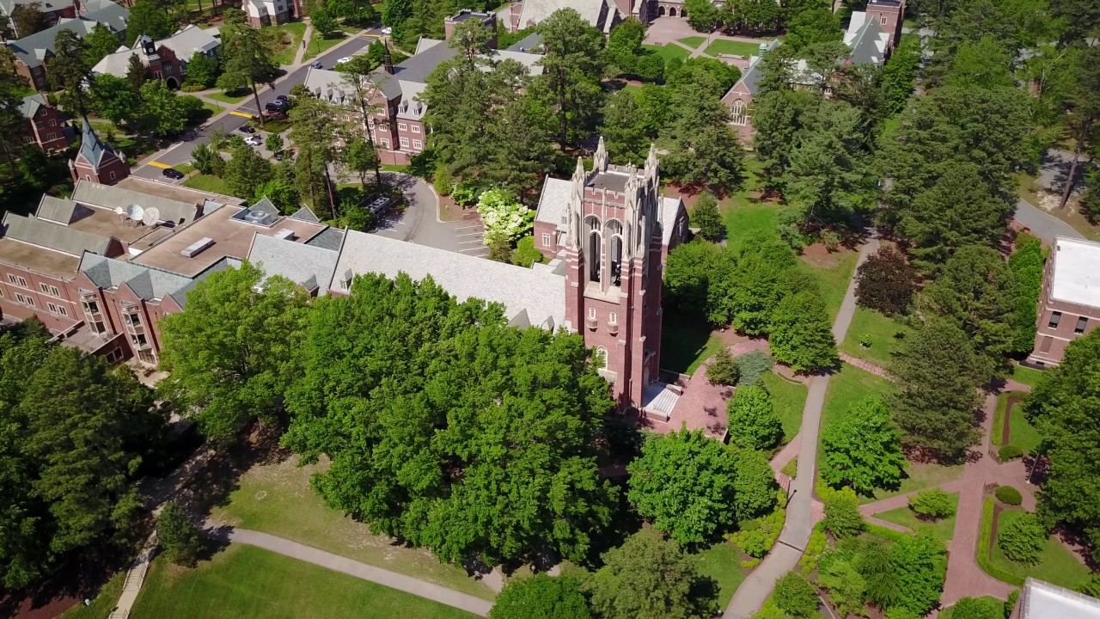

Motivation

Slide 4

Questions
How prolific are UR faculty in journal scholarship?
How many journal articles do UR faculty publish?
What journals do they publish in?
How many different journals?
How many articles are published in each journal?
What authors (departments) publish the most?
Who & what do these counts miss?

Slide 5
Getting Started with Data
STEP 1
STEP 2
STEP 3
STEP 3
Locating data:
CrossRef API data: 6m
Missing data fields
Another data source needed…
Use Web of Science – 4,700 - CSV import
Manipulate and Analyze Data
-GroupBy!!
-Bar Charts
-Line Graphs
-Pie Chart
Realize all that isn’t there!

Slide 6
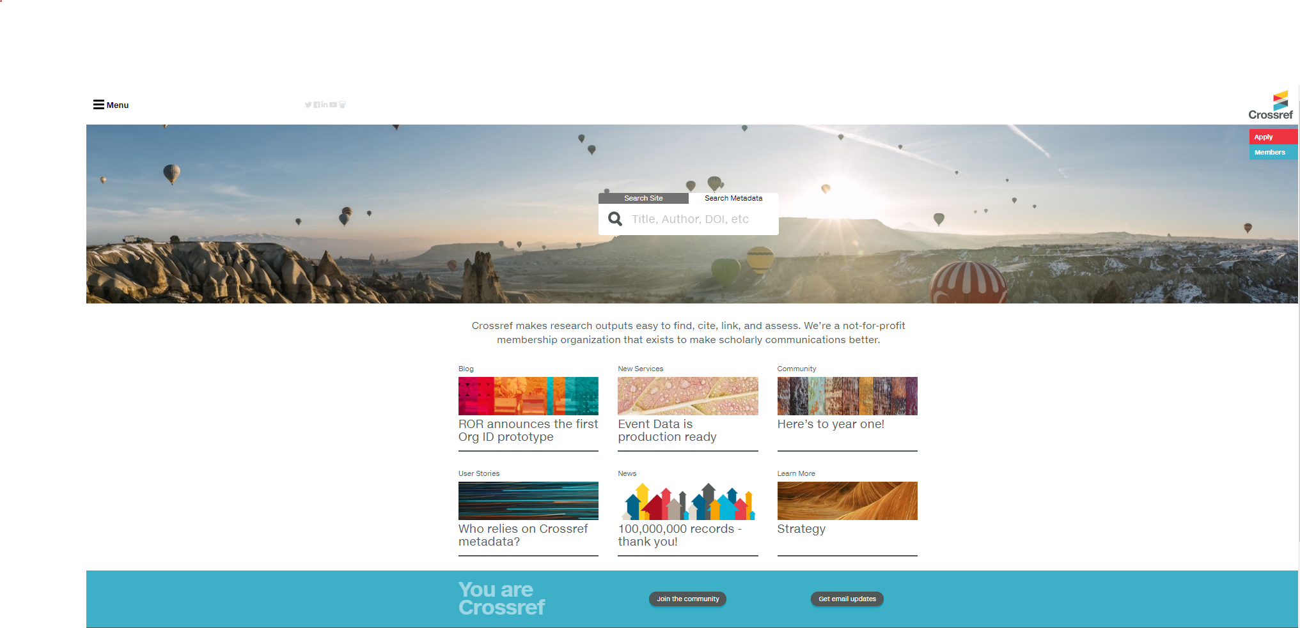
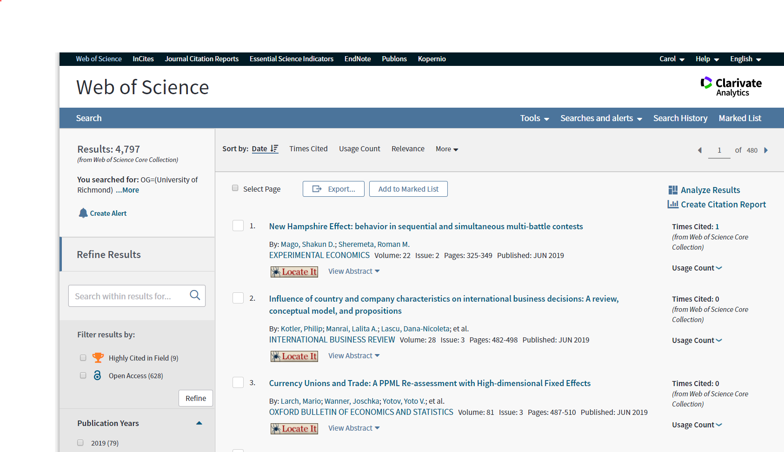
Data:
CrossRef
Web of Science

Slide 7
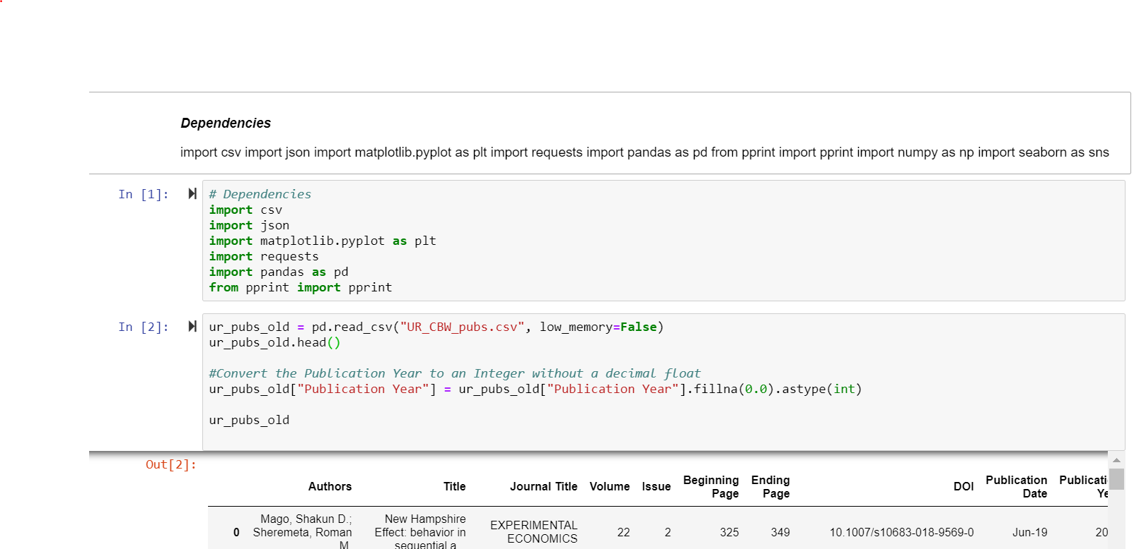
How much is published?
Journals indexed in Web of Science
1976-present
Affiliation: University of Richmond
4,708

Slide 8

Analysis
JOURNAL Information:
What journals are faculty publishing in?
How many different journals are there?
How many articles are published in each journal?
AUTHOR Information:
What authors (departments) publish the most?

Slide 9
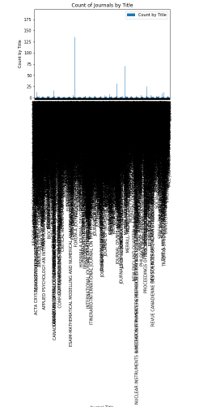
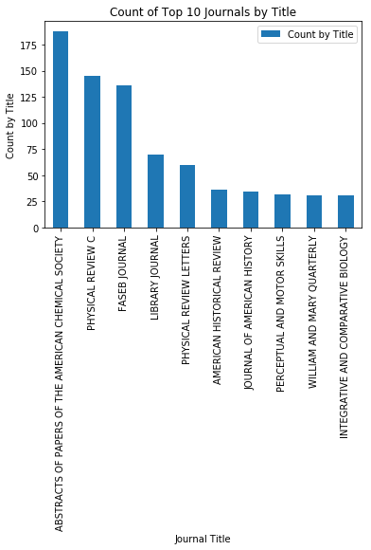
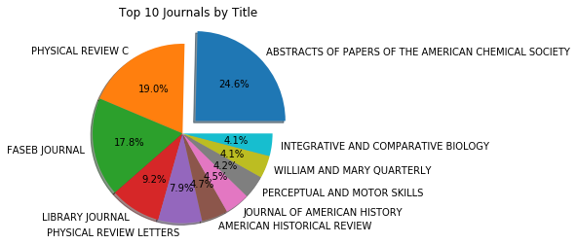
Top 10 Journal Titles By Publication
Oops…all journals isn’t a pretty visual…

Slide 10
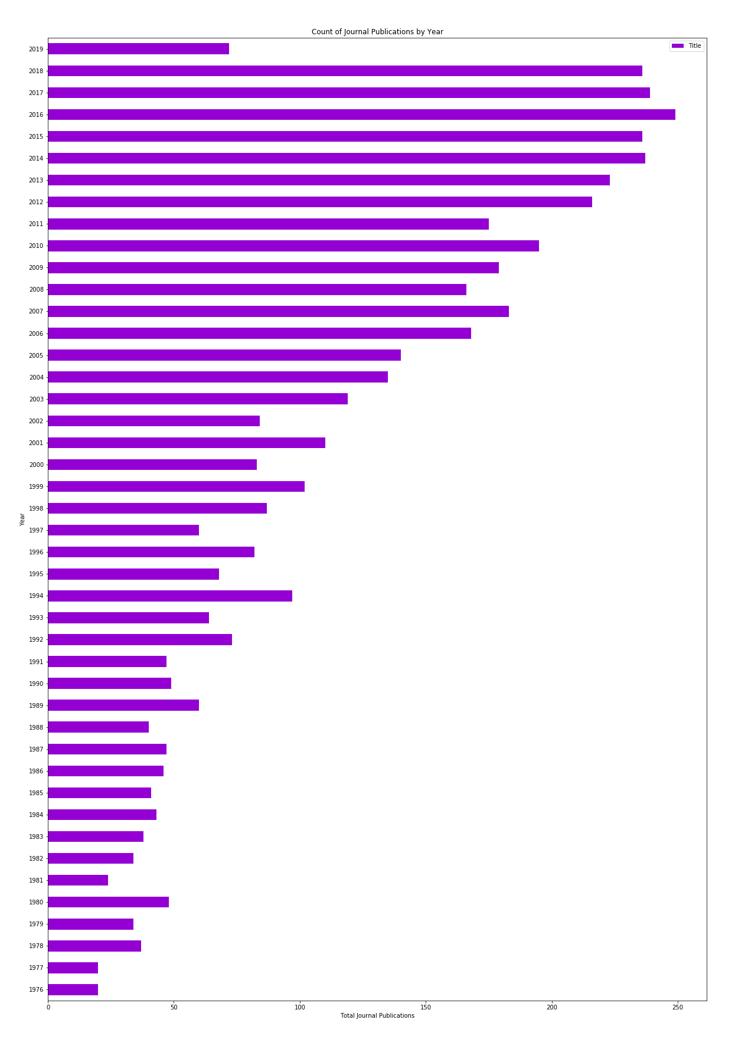
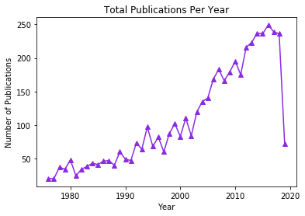
Total Publications By Year

Slide 11
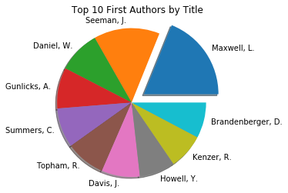
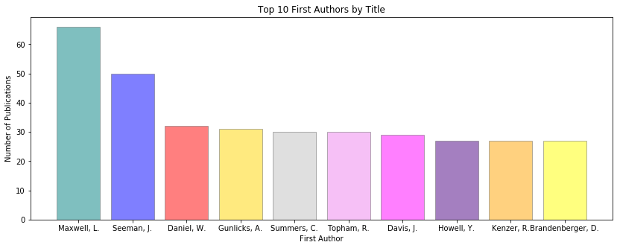
Top 10 Authors – Number of Journal Publications

Slide 12
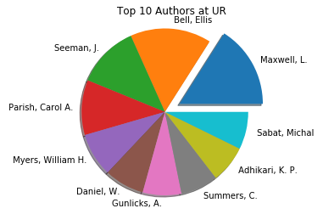
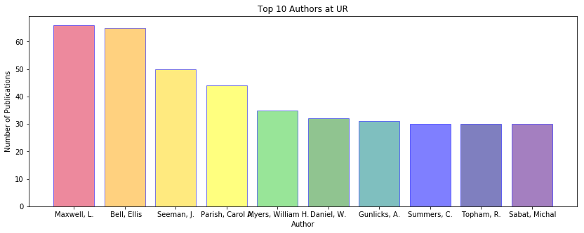
Top 10 Authors – Total # of Journal Publications

Slide 13
BUT…Who & What Do These Counts Miss?
Science & STEM
Humanities
Web of Science Includes

Slide 14

BUT…Who & What Do These Counts Miss?
And…Where’s Kristine?

Slide 15

Questions?

